Slide 1
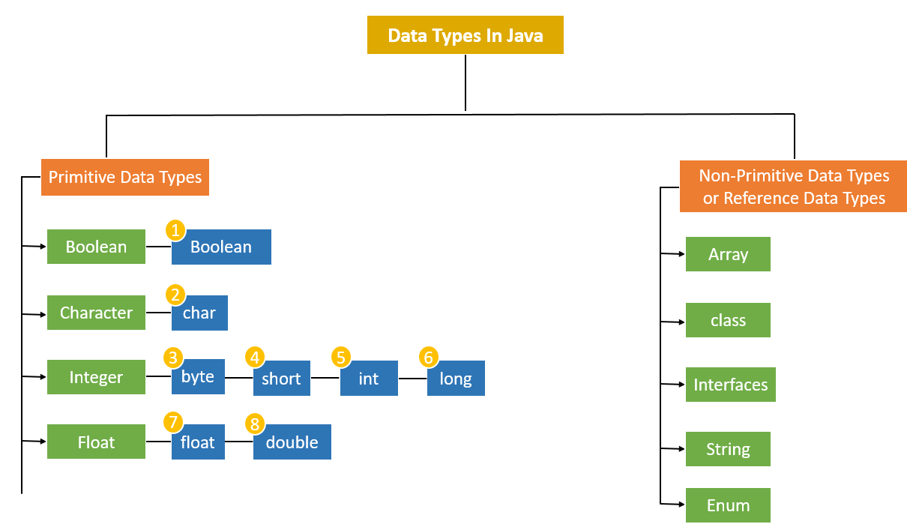
Data types:
1 bit
2 bytes
1 byte
2 bytes
4 bytes
8 bytes
4 bytes
8 bytes

Slide 2
Module-3:
INTERFACES AND PACKAGES

Slide 3
Data Abstraction
Abstract Classes and Interfaces

Slide 4
What is an interface?
In Java, an interface is a reference type, similar to a class, that can contain only
public and abstract methods (Starting with Java 8, you can also have default and static methods in an interface)
public static final fields.
It cannot have Constructor
Interfaces specify what a class must do, but not how it does it.
A class that implements an interface must implement all of its methods unless it is an abstract class.
Interfaces are used to achieve:
Abstraction,
Multiple Inheritance, and
Loose coupling between components in Java.

Slide 5
What is Abstract Method:
An abstract method is a method declared without a body. It must be overridden in the subclass. The method signature includes the abstract keyword, and there is no method body.
Key Rules for Abstract Methods:
Must be declared in an abstract class.
Cannot have a method body.
Subclasses that extend the abstract class must override the abstract method.

Slide 6
final Fields (Constants): When we use a final Keywork with a variable it becomes Constant or final Variable.
When Used with Variable
Ex: int age = 20
It Becomes Constant
Ex: final int age = 20

Slide 7
What is Abstract Class:
An Abstract Class in object-oriented programming is a class that cannot be instantiated directly. It serves as a blueprint for other classes. Abstract classes are used when you want to define some common behavior (methods) that other classes should inherit and implement, but the abstract class itself should not be instantiated. In other words, an abstract class can have abstract methods (without implementation) and/or concrete methods (with implementation).

Slide 8
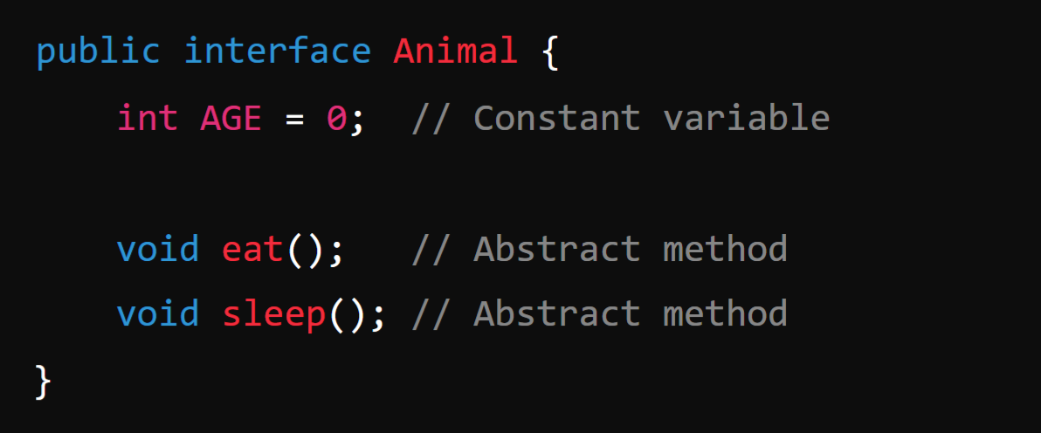
Defining and Creating an interface:
Declaration: An interface is declared using the interface keyword:
Note:
By default all the Methods inside an interface is Abstract methods and also all the fields in inside an interface are final or constant.

Slide 9
2. Implementation by a Class:
A class can implement an interface by using the implements keyword. The class must provide implementations for all of the interface's abstract methods.
Example:
In this example, Dog implements the Animal interface and provides concrete implementations of the eat() and sleep() methods.

Slide 10
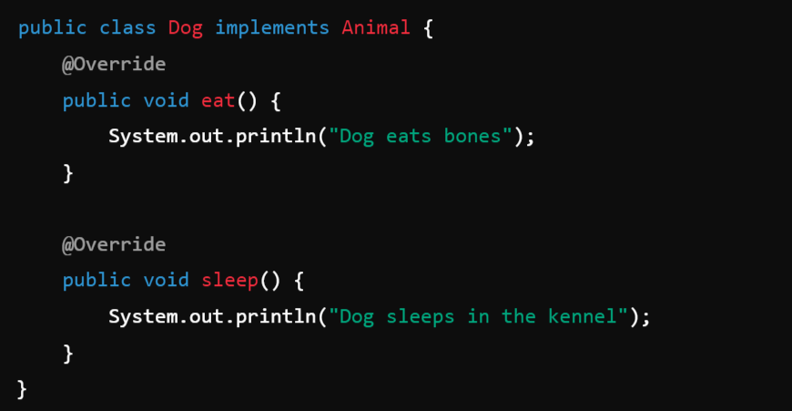

Slide 11
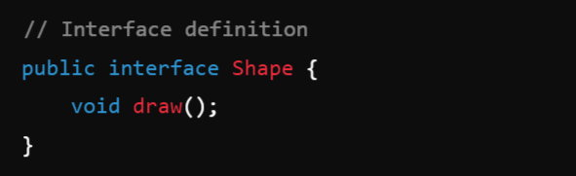
Accessing implementations through interface references:
This means that you interact with an object of a class that implements an interface via a reference of that interface type, not the class type. This allows you to use the object polymorphically, meaning that the actual implementation is determined at runtime, but you interact with it using the common interface methods.
Example:
1. Below Code is for Creating an interface with name Shape

Slide 12
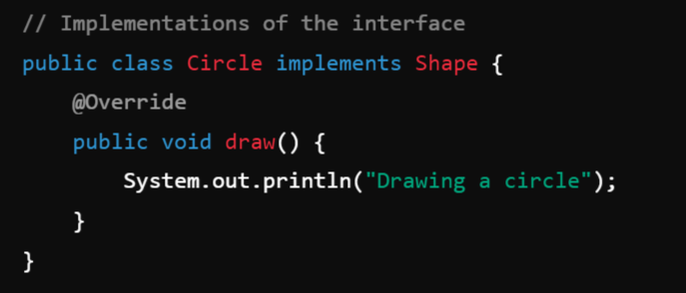
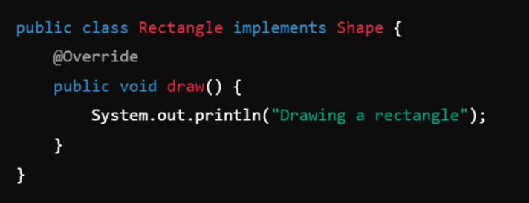
2. Class Circle implements the Interface Shape:
3. Class Rectangle implements the Interface Shape:

Slide 13
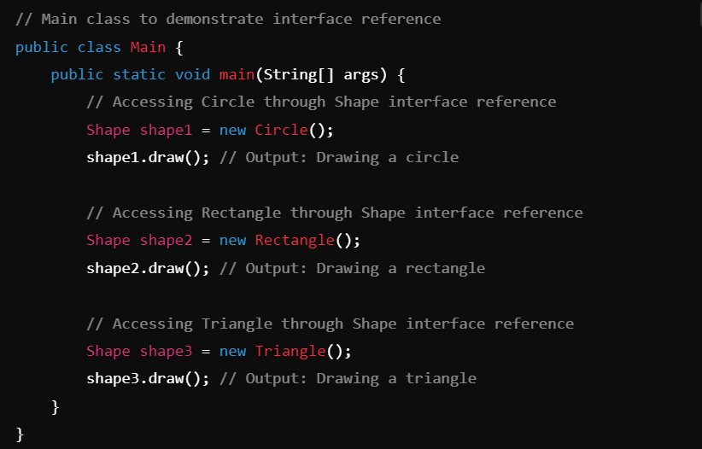
Main Class:

Slide 14
Extending interface:
In Java, interfaces can extend other interfaces, similar to how classes can extend other classes.
When one interface extends another, it inherits all the abstract methods, default methods, and constants (static and final fields) from the parent interface. This allows you to create a more specialized interface by building upon an existing one.
Unlike classes, where a subclass can only extend one parent class (due to single inheritance), an interface in Java can extend multiple interfaces, allowing for a form of multiple inheritance.

Slide 15
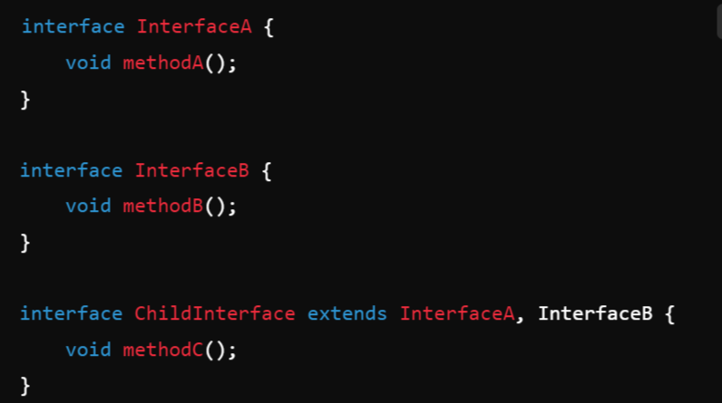
Syntax:

Slide 16
Interfaces VS Abstract classes:
In Java, both interfaces and abstract classes are used to define abstract types, which cannot be instantiated directly.
Data Abstraction -> Abstract class & Interfaces.

Slide 17
Feature | Interface | Abstract Class
Created Using | interface Keyword | abstract keyword
Multiple Inheritance | Yes | No
Default Methods | Yes (Java 8+) | No (but can have concrete methods)
Static Methods | Yes (Java 8+) | Yes
Fields | Public, static, and final only | Any type of field
Constructors | No | Yes (cannot instantiate directly)
Method Modifiers | Public (Java 9+ allows private methods) | Can be public, private, protected
Abstract/Concrete Methods | Abstract, default, or static | Both abstract and concrete methods
Use Case | To define capabilities (behavior) | To define a base class (object template)
Inheritance | A class can implement multiple interfaces | A class can extend only one class

Slide 18
Encapsulation
Encapsulation is a key Java OOP principle that is implemented mostly through packages.

Slide 19
packages :
The packages in Java Language is nothing more than directories that gathers related classes, interfaces, and sub-packages based on their functional relationships in java.
A large project’s classes can be organised using Java packages, which can aid in the implementation of encapsulation.

Slide 20
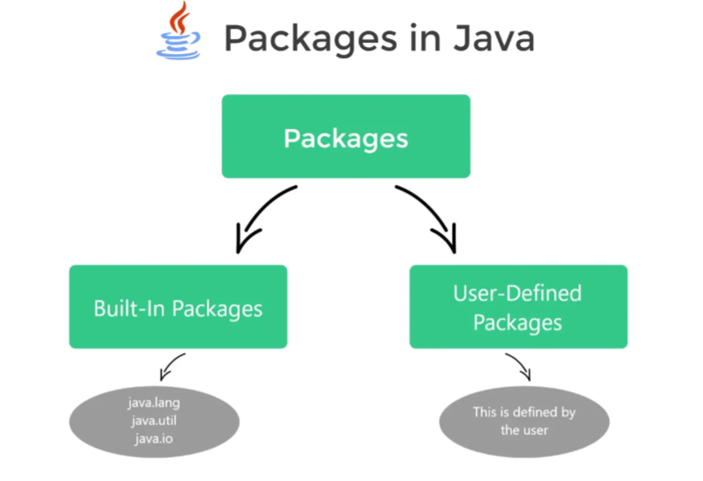
2-Types

Slide 21
1. pre-defined packages:
In java, we already have a number of pre-defined packages that contain a large number of classes and interfaces. These packages are known as Built-in packages and we can directly import them in our code.
Some commonly used built-in packages are:
java.io: Data streams, serialisation, and the file system are all supported by this package for system input and output.
java.lang: contains classes that are essential to the design of the Java programming language.
java.math: Classes in this package perform arbitrary-precision integer arithmetic (BigInteger) and arbitrary-precision decimal arithmetic (BigDecimal).
java.util: The collections framework, some internationalisation support classes, and a few utility classes are included.

Slide 22
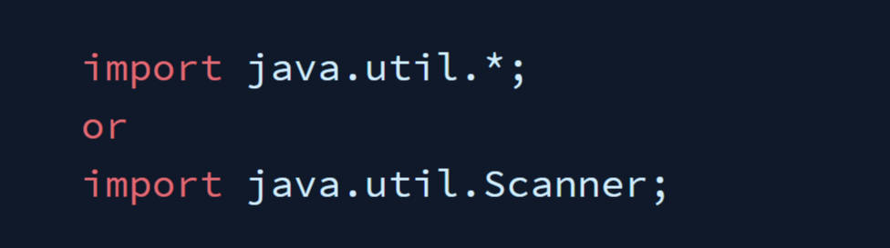
How to use Built-In Packages:

Slide 23
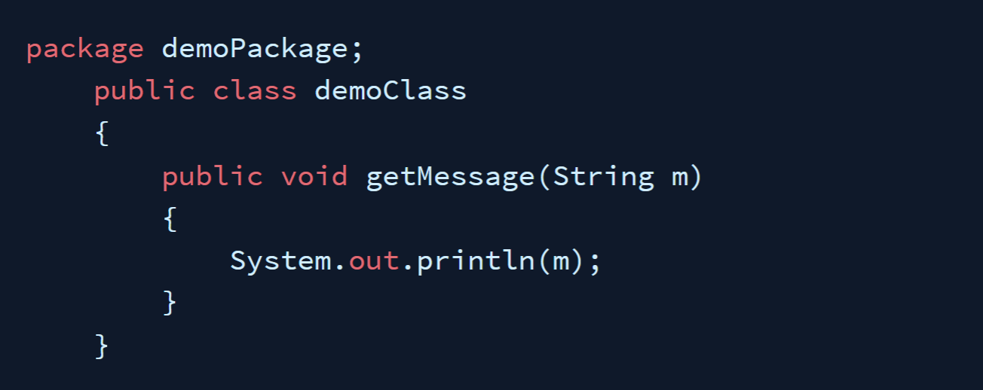
2. User-Defined Packages:
Java also allows you to make your own packages. These are referred to as user-defined packages.
1. Creating a Package: To Create a package use the package keyword at the top of your file, the automatically all the class below the package name will be placed inside of that package.

Slide 24


2. Accessing a Package:
We can access all the classes and interfaces inside of any package by using import Keyword or Fully Qualified Class Name.
Importing a Package Using import Keyword:
Importing a Specific Class: If you want to import a specific class from a package, use:
Importing All Classes from a Package: If you want to import all classes from a package, use a wildcard *:
2. Using Fully Qualified Class Name:

Slide 25
Points to Remember:
Either import the class or use the fully qualified class name in order to access code that is located outside the current package.
Using packages while coding provides code reusability benefit.
Packages allow us to uniquely identify a class.
Access control features include protected classes, default classes, and private classes.
They enable the hiding of classes, preventing other programmes from accessing classes intended for internal use only.
You can better organise your project and find related classes by using packages.

Slide 26
Understanding CLASSPATH:
The CLASSPATH in Java is a critical concept that helps the Java Virtual Machine (JVM) and the compiler find and load compiled class files (.class) and external libraries (typically .jar files) that your application depends on.
The CLASSPATH is an environment variable (or can be specified as a command-line option) that specifies the locations where the JVM and the Java compiler should look for .class files and libraries.
These locations can be:
Directories containing .class files.
JAR (Java ARchive) files containing libraries.
ZIP files containing compiled Java code.
By default, the JVM looks in the current directory for class files, but the CLASSPATH allows you to tell Java to look in other directories or files as well.

Slide 27
Why is CLASSPATH Important?
When you compile or run a Java program, the JVM needs to know where to find the classes that your code references. If the JVM can't locate a class, it will throw a ClassNotFoundException or a NoClassDefFoundError.
For example, if your project relies on external libraries or classes that are stored in different locations, you need to include these paths in the CLASSPATH so that Java knows where to find them.
You can set the CLASSPATH in two ways:
Temporarily: via the command line when compiling and running a Java program.
Permanently: by setting it as an environment variable.

Slide 28
Setting CLASSPATH in Command Line
You can specify the classpath using the -cp or -classpath option when running the javac (compiler) or java (JVM) commands.
For example, to compile and run a Java program that depends on classes in a directory or JAR file:
Example:

Slide 29
Module-3: INTERFACES AND PACKAGES (5 hrs)
Interface: Interfaces VS Abstract classes, defining an interface, implement interfaces, accessing implementations through interface references, extending interface.
Packages: Defining, creating and accessing a package, understanding CLASSPATH, importing packages

